Slide 1

Exploratory Data Analysis
G2M insight for Cab Investment firm
11/19/2022

Slide 2

CONTENTS
1. Problem Statement
2. Approach
3. EDA
4. EDA Summary
5. Recommendations

Slide 3
Problem Statement
XYZ is a private firm in the US. Due to remarkable growth in the Cab Industry in the last few years and multiple key players in the market, it is planning for an investment in the Cab industry and as per its Go-to-Market(G2M) strategy, they want to understand the market before taking a final decision.

Slide 4
Approach and Analysis
1. Four individual data sets of a time period ranging from 31/01/2016 to 31/12/2018 were provided
2. Formatted, compiled, and cleaned in one single dataset(used the Left join and merge function to create a final data set )
3. Performed sanity checks like null values check, duplicate value check, and data type check.
4. There were no null values or duplicates. However, the default datatype was incorrect, hence changed them using the ‘as type and date time’ function.
5. Graphical visualization will be employed

Slide 5
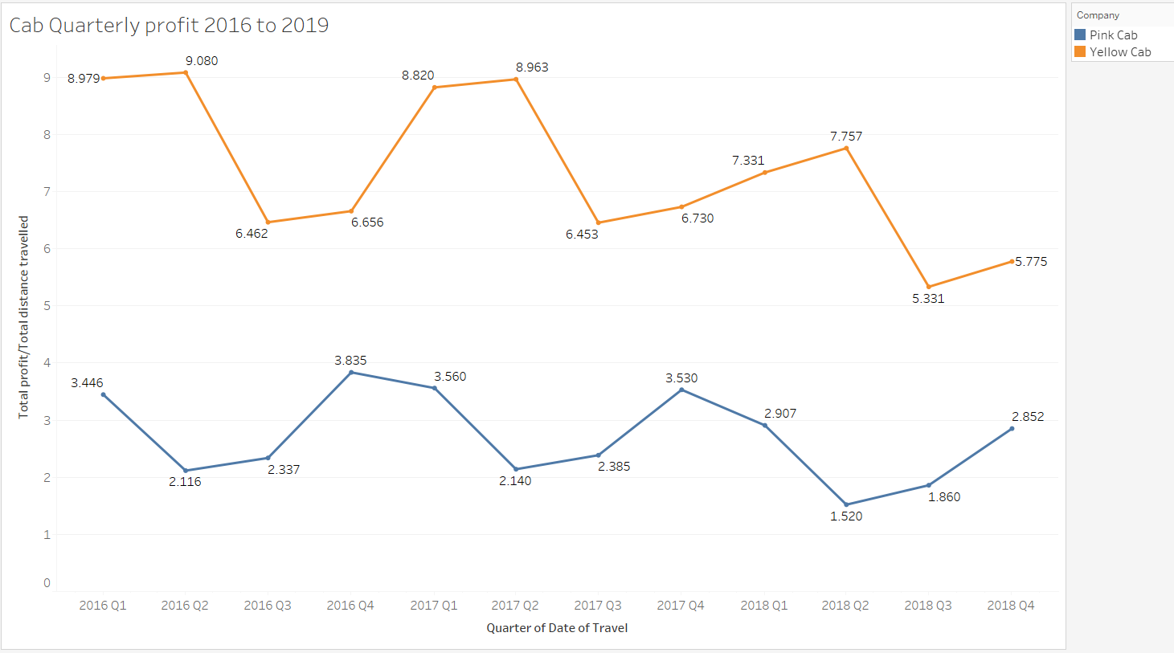
Quarterly profit analysis
Seasonal component is seen in both cabs
Increase in profit is seen every 2nd quarter of the year for yellow cab
Decrease in profit is seen every 2nd quarter of the year for pink cab

Slide 6
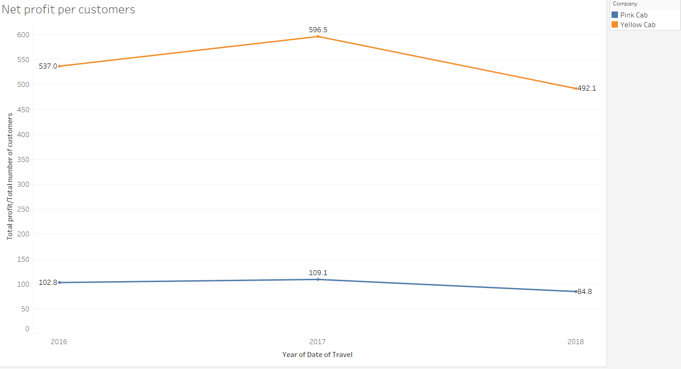
Profit analysis by customers
Yellow cab has more profit /customers than Pink cab

Slide 7
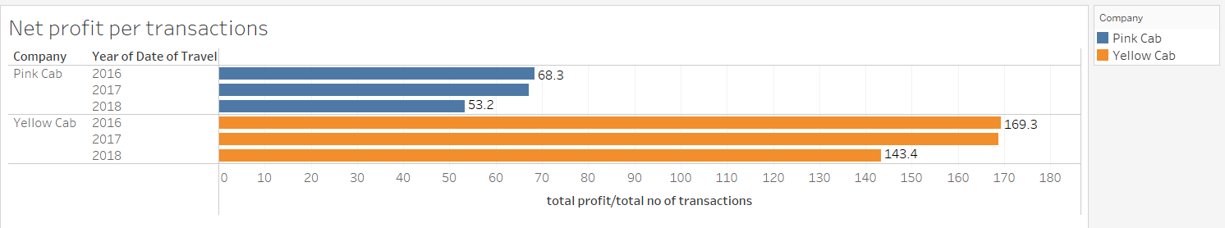
Profit analysis by transactions
Net profit/transaction is higher for the yellow cab

Slide 8
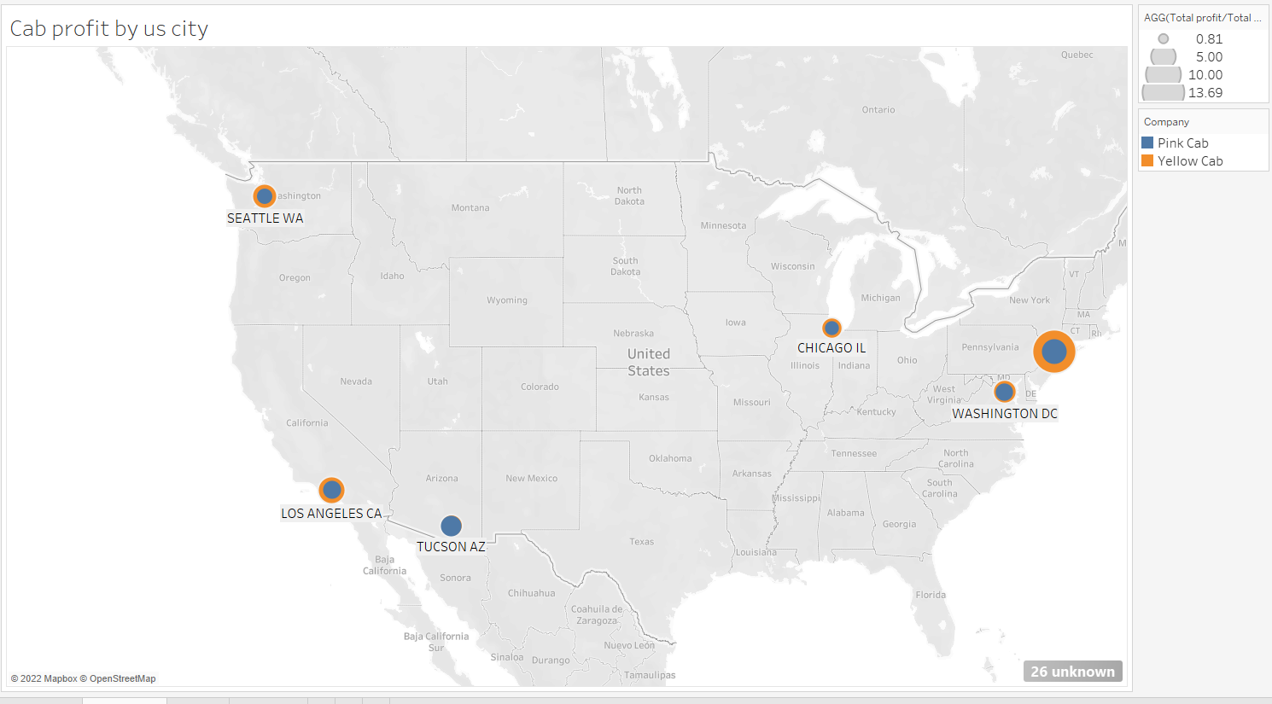
Profit analysis by US city

Slide 9
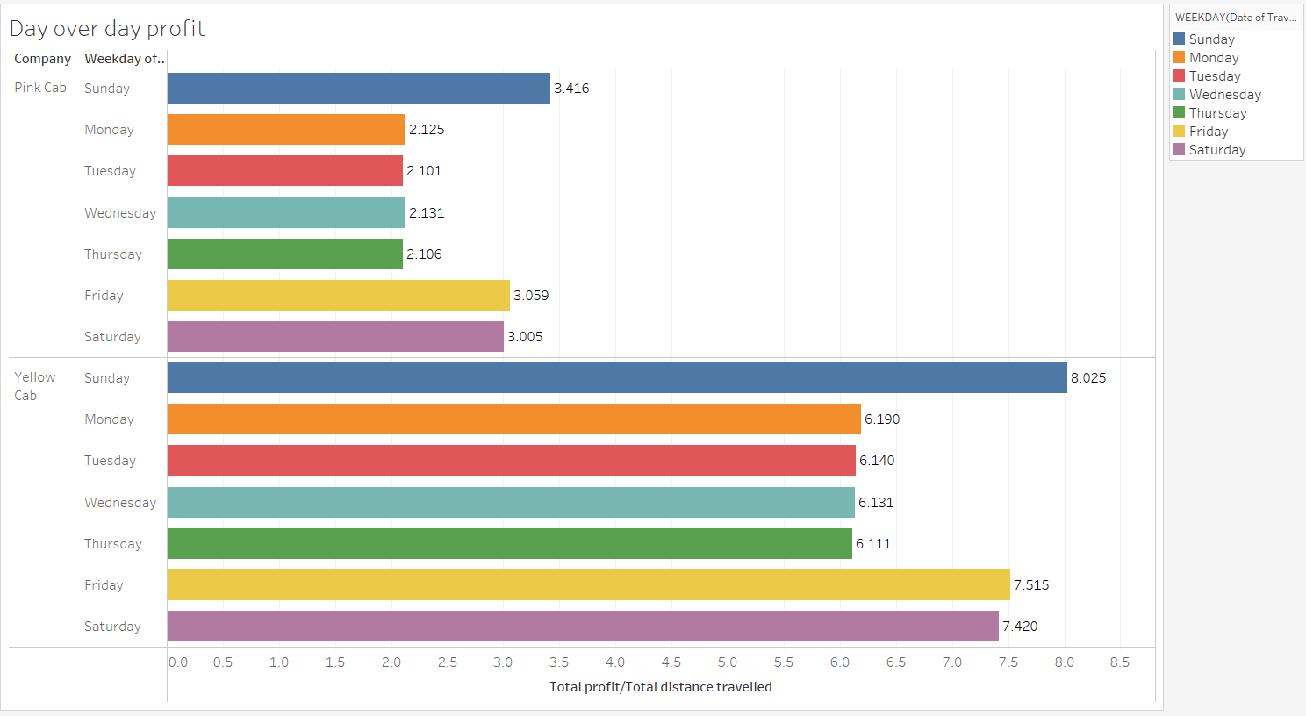
Day-over-day profit

Slide 10
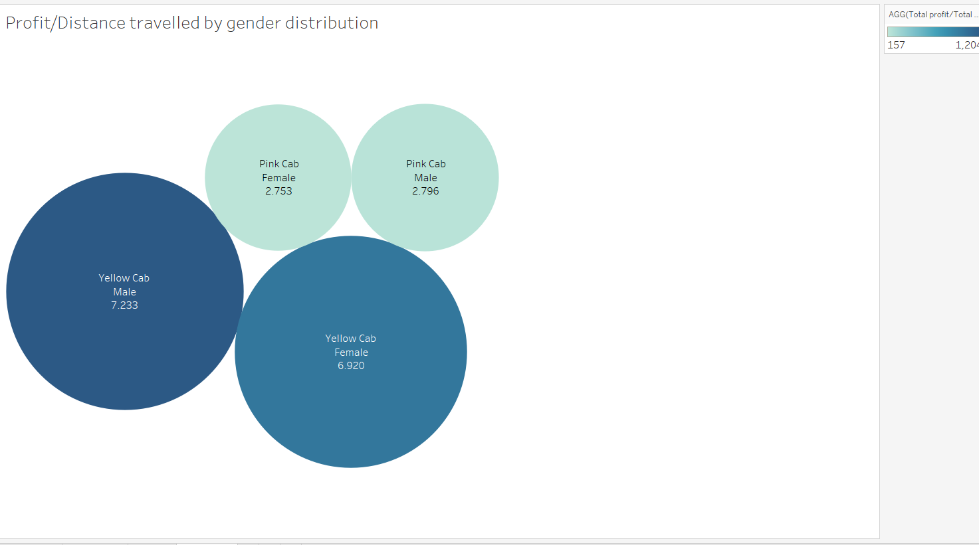
Profit/distance travelled by gender distribution
There is no significant gender distribution for profit, but Yellow cab has more profit than the pink cab

Slide 11
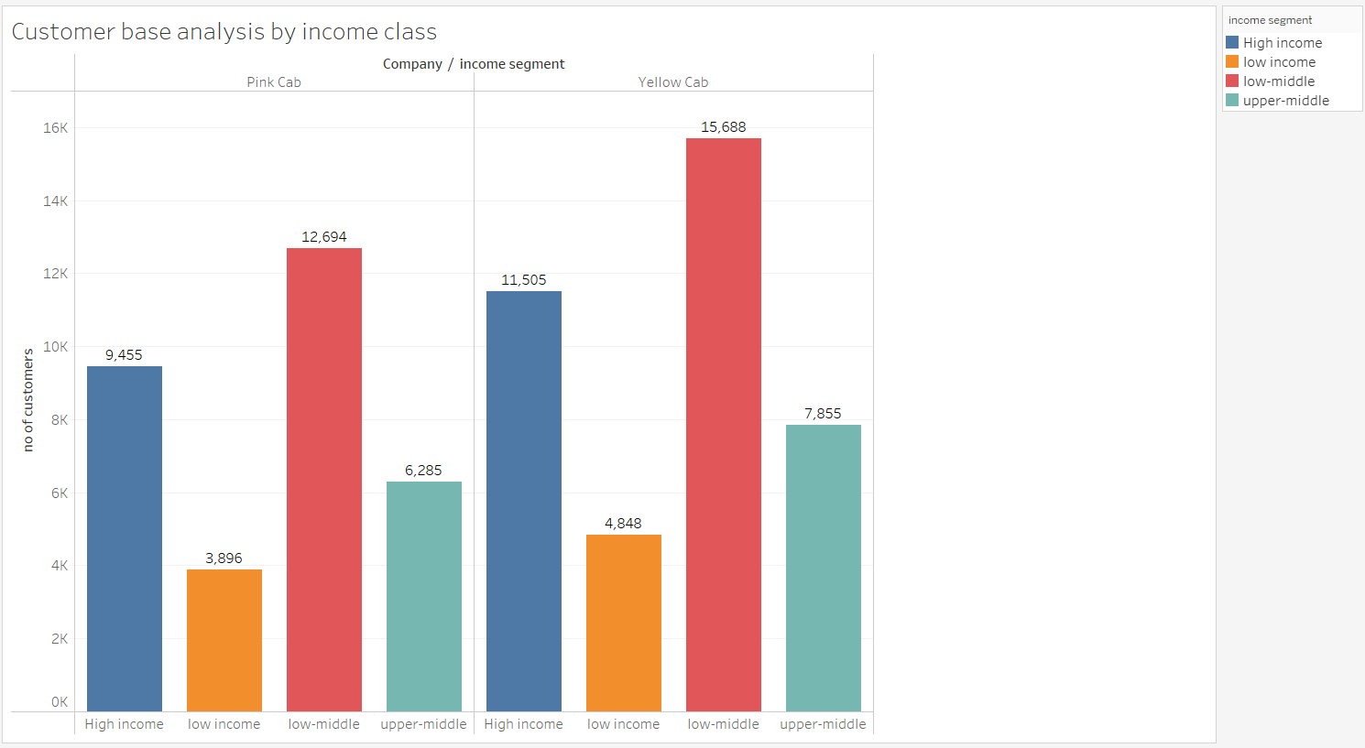
Customer base analysis by Income class
Grouped the customers based on Income
If income <5000, ‘Low income’, between 5000 and 15000- ‘lower-middle’,15000 to 20000- ‘upper-middle’, and >20000- ‘High income’

Slide 12
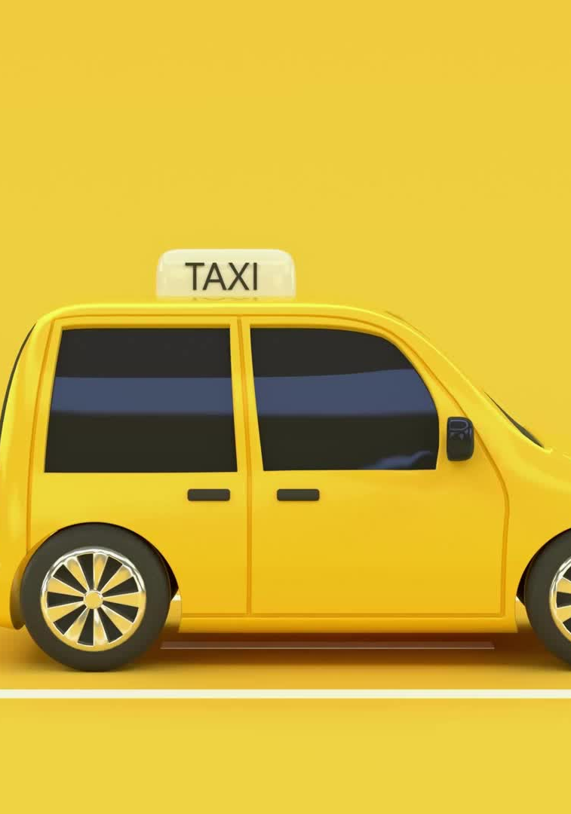
Recommendation
Based on the data provided and analysis done, Yellow cab is the best option for Investment
Quarterly profit/distance traveled is high for yellow cab than pink cab
Yellow cab has more transactions i.e., more rides than the pink cab
High Income and low-middle category are much higher in the yellow cab than pink cab

Slide 13
THANK YOU

